Slide 1
What determines Earth’s surface temperature?
Heat flow from Earth’s interior is ca. 47 TW
Amount of solar radiation striking the Earth is ca. 173,000 TW
~ 99.97 % of total energy flow to Earth’s surface
Notes:
https://en.wikipedia.org/wiki/Earth%27s_internal_heat_budget

Slide 2
Energy Fundamentals
Energy = Ability to produce change in the state or motion of matter.
    Or the ability to do work, where W = F * D & F = M * A
Energy comes in many interchangeable forms: mechanical, electrical, chemical, sound, heat, electromagnetic radiation
First law of thermodynamics – Energy in never created or destroyed.
Heat = random, incoherent motion of atoms and molecules.
The more modes of motion, the more heat energy atoms/molecules can transport.
The amount of energy per mode of motion = ½ kT
K = Boltzmann constant = 1.38*10⁻²³ J/K
T = temperature (K)

Slide 3
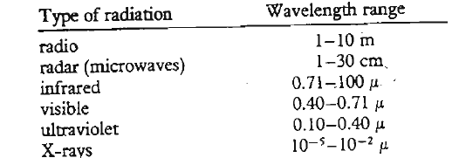
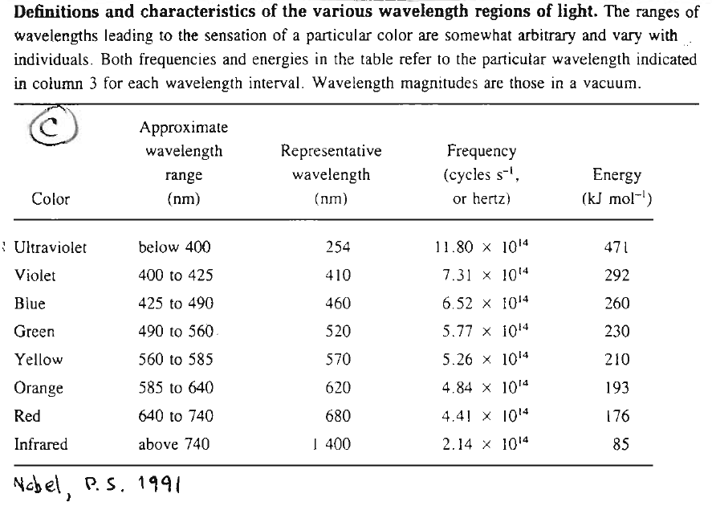
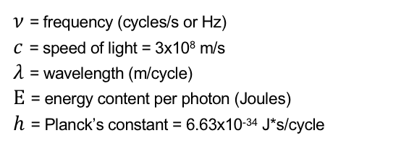
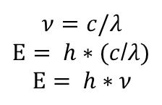
Electromagnetic Radiation (EMR)
Consists of photons – discrete packets of E that can be considered a “ripple” in the electromagnetic field of space.
EMR can transport energy through the near vacuum of space.
Photons are emitted or absorbed as a result of relatively discrete changes in the electronic energy levels of atoms or the vibrational & rotational energy levels of molecules.
To be maintained, these “ripples” (photons) move at the speed of light (3x10⁸ m/s)
Photons can be described as travelling waves that are characterized by their wavelength.
$$ν=c/λ$$
$Ε= h∗(c$/$λ)$
$$Ε= h∗ν$$
𝜈 = frequency (cycles/s or Hz)
$c$ = speed of light = 3x10⁸ m/s
𝜆 = wavelength (m/cycle)
$Ε$ = energy content per photon (Joules)
$h$ = Planck’s constant = 6.63x10⁻³⁴ J*s/cycle
Blackbody – An object that absorbs all EMR that strikes it and emits the maximum amount of EMR that is possible for each wavelength emitted by an object at a given temperature.

Slide 4
Radiation Laws
e
e
e
e

Slide 5
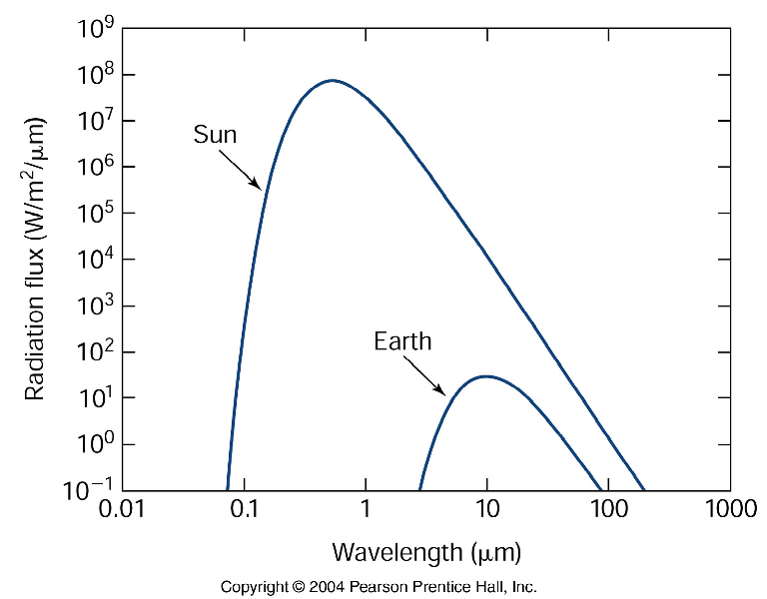
Notes:
Chl a absorbs around 425 and 675 nm

Slide 6
How Light Interacts with the Atmosphere
Light has three fates:
1) transmitted (doesn’t interact)
2) absorbed (increased E state of atoms or molecules)
3) scattered/reflected (redirected) without being absorbed
Absorption:
Gases are ”choosy” absorbers, condensed matter is less “choosy”
Photons interact with & increase the internal energy state of atoms or molecules through a change in:
e⁻ excitation
rotational energy
vibrational energy (compression, stretching, & bending)
New energy states are discrete
Limited to certain energy values (frequencies/wavelengths)
Frequency/wavelength specific
∆ E_{vib}= E_{photon}= ℎ𝜈 = ℎ𝑐 /𝜆
To absorb a photon of EMR, the atom/molecule must be able to produce an oscillating electric field with a frequency that matches the frequency of the electric field of the photon. They must be “in tune” with each other.
Molecules can produce oscillating electric fields if their vibrations create an asymmetrical charge distribution (a dipole).
Absorbed EMR energy can be dissipated in several ways including:
Emission of photons of EMR
Radiationless transitions that produce heat
https://www.youtube.com/watch?v=aCocQa2Bcuc

Slide 7
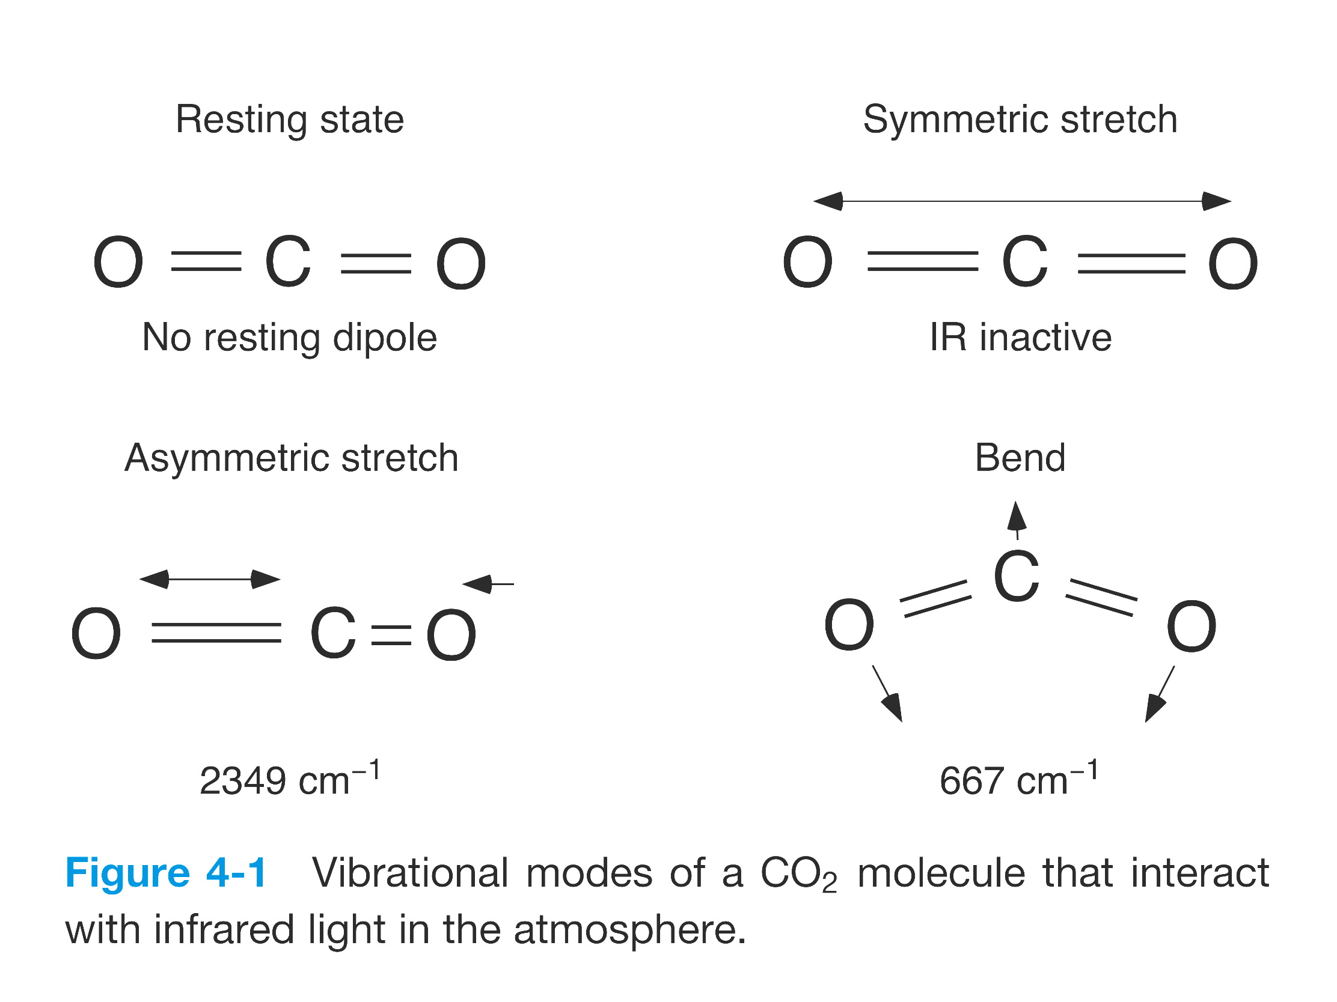
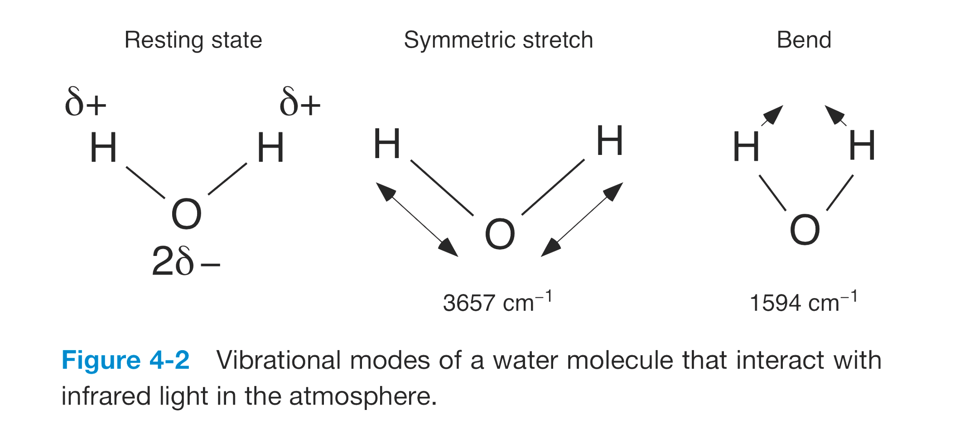
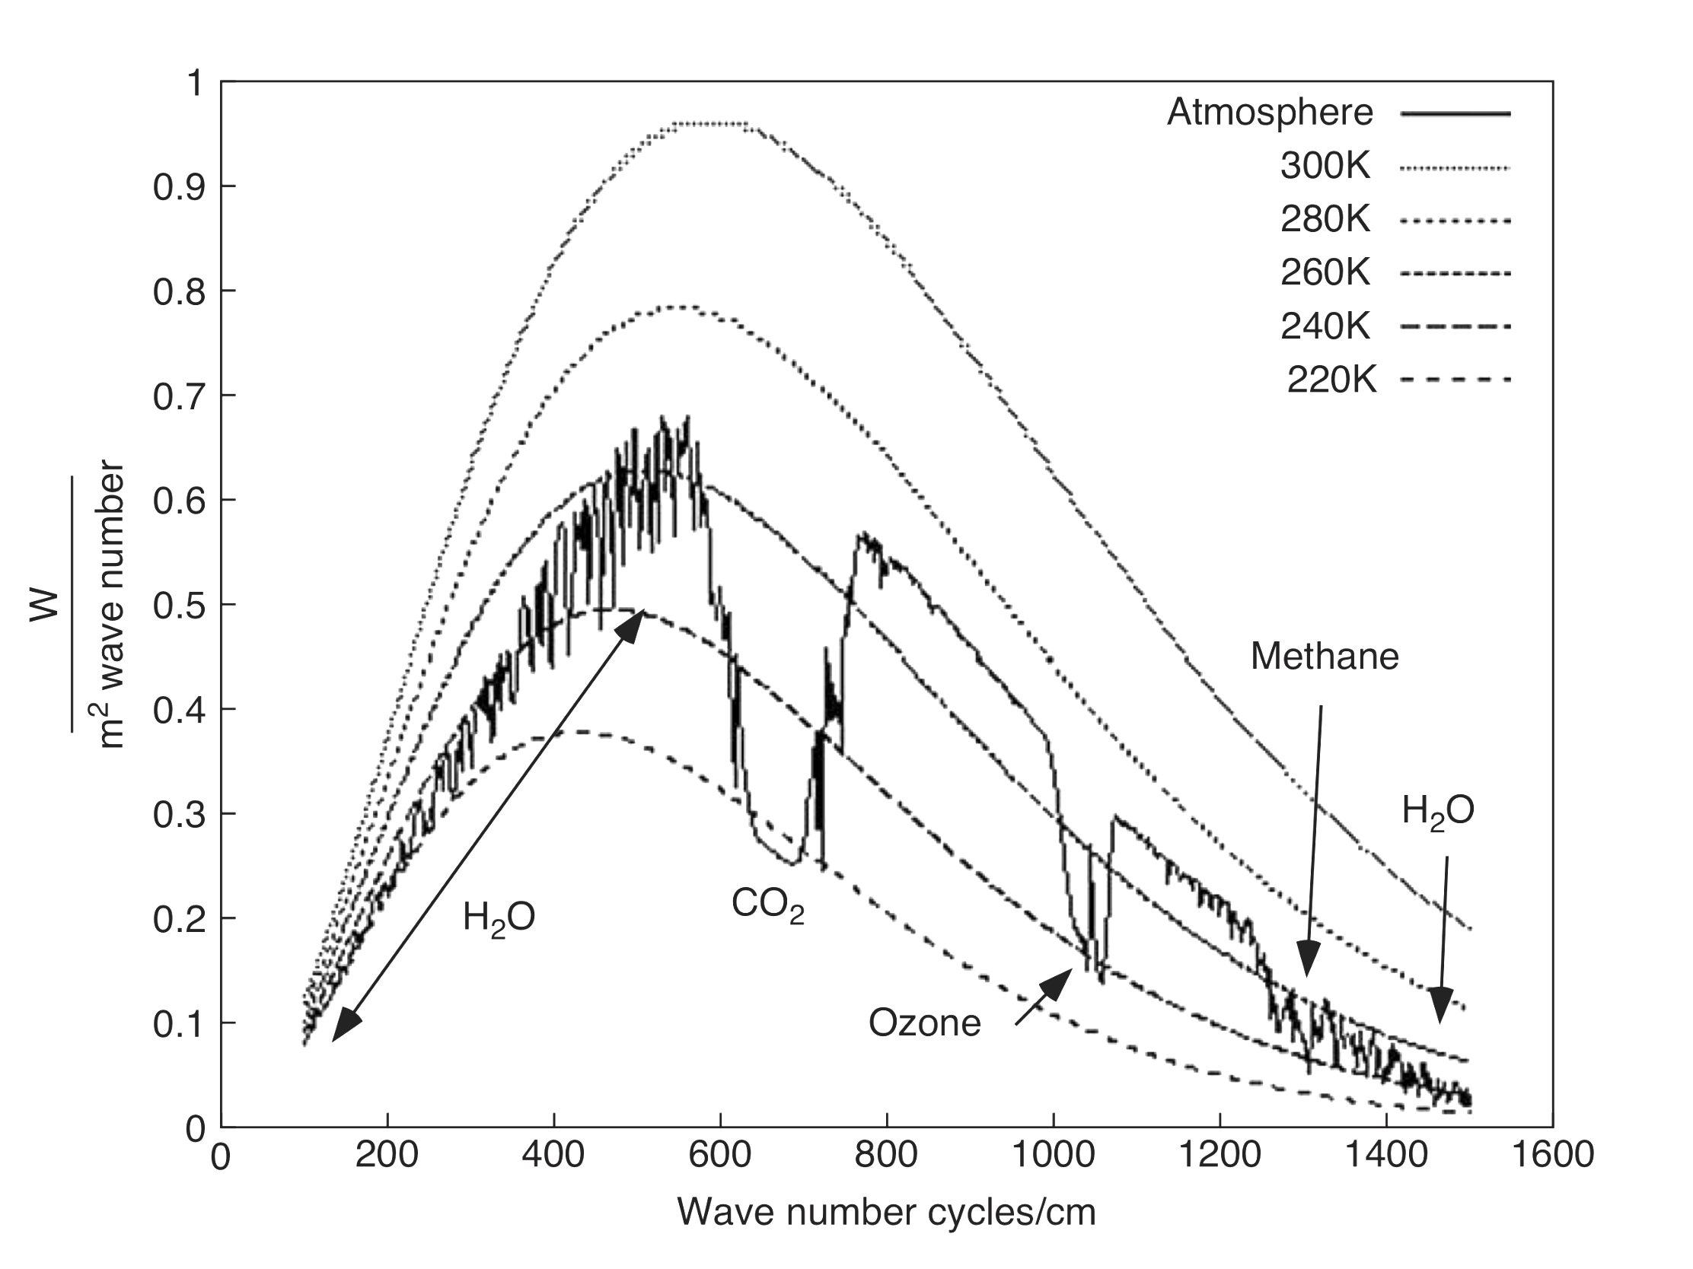
How Earthlight Interacts with Greenhouse Gases
Wavelength/frequency matters
Greenhouse gases are transparent to (not in tune with) solar radiation
BUT they are not transparent to wavelength-specific portions of terrestrial radiation.
Atmospheric
Window
Rotational
&
Bending
Rotational
Bending

Slide 8
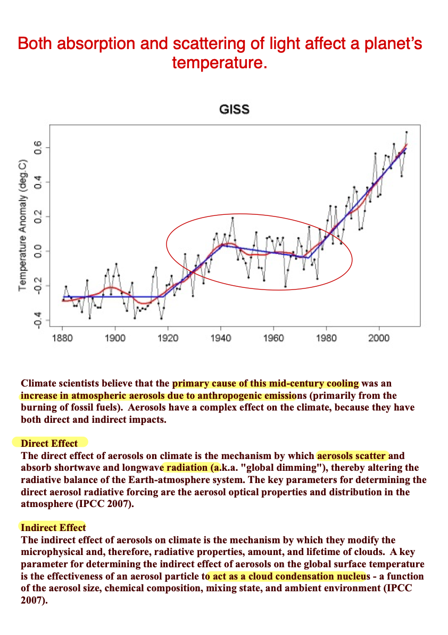

Slide 9
Charlson and Wigley 1994

Slide 10
How much light do human-produced sulfate aerosols directly reflect to space?
For sulfate aerosols:
I/I_{o} = e^{-δx} Beer’s Law with x = 1 because we’re considering the entire column of air
Where:
Optical depth = scattering effectiveness of column = δ = α * β
α = Empirically know scattering efficiency
β = Average amount of aerosol in column of air
β = Q*t/area ➔ Amount = (Input rate * Mean residence time)/area
Where:
Q = Total input (amount per unit time) => measured
t = Mean residence time (years) => known
Determine δ and plug into Beer’s Law to estimate fraction scattered.
Correct for amount scattered to space (15%) & cloud-free cover (~50%)
When appropriate values are used:
~0.21% of sunlight (340 W/m²) is directly scattered back to by anthropogenic sulfate aerosols (~0.71 W/m²).

Slide 11
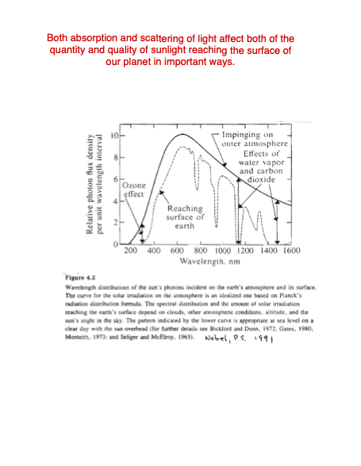

Slide 12
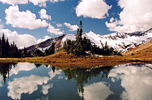
Why is the sky blue & the clouds white?
Rayleigh Scattering when scattering material << λ
Scattering efficiency α 1/λ⁴
Mie Scattering when scattering material ≥ λ
All λ scattered equally

Slide 13
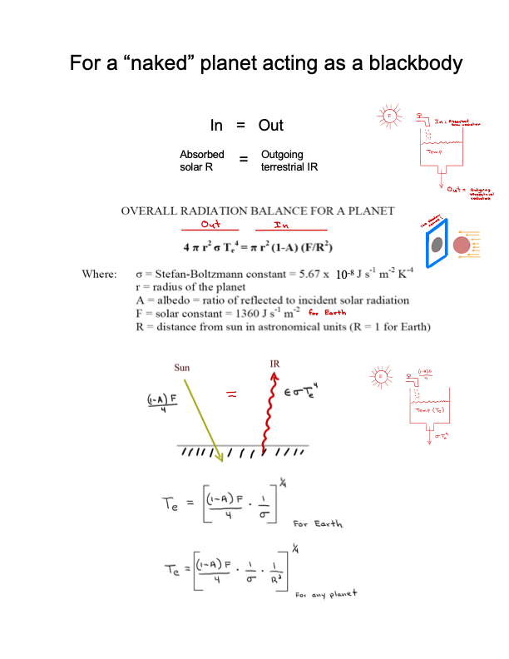

Slide 14
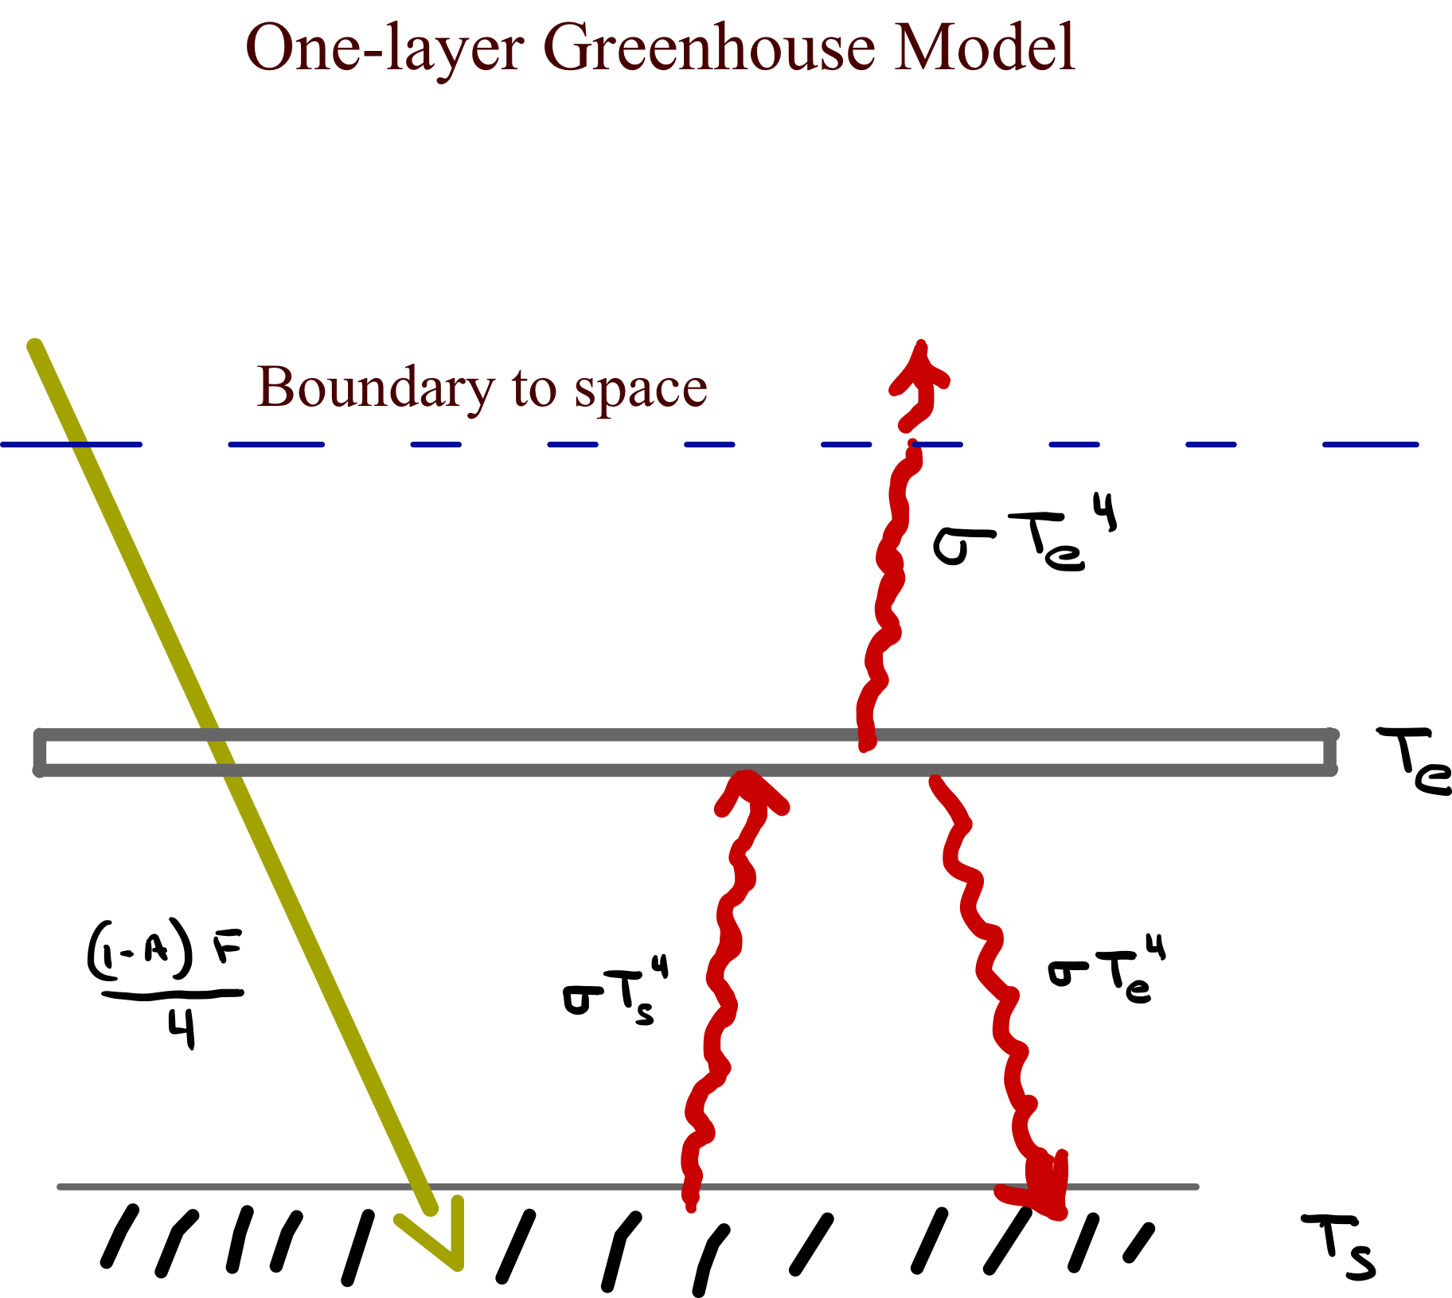
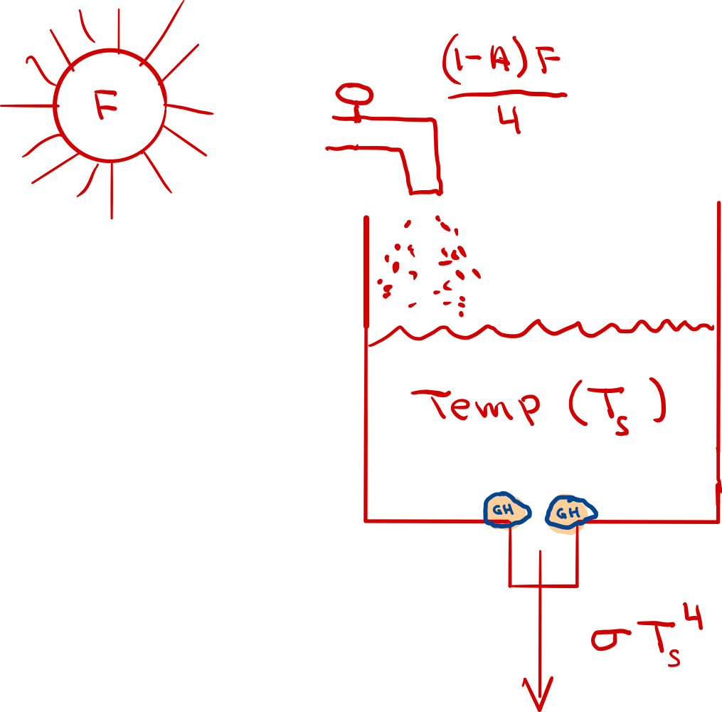
A partially “clothed” planetary climate model

Slide 15

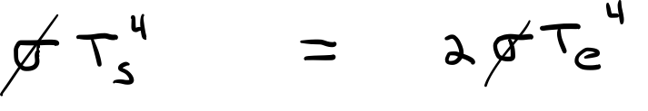
For the atmosphere in a one-layer model
T_{s} = 2^{1/4} T_{e}
= 303 K
Too hot !
In general we can determine that for layers (radiation zones)
behaving as black bodies
T_{s} = (n+1)^{1/4} T_{e}
where n = # of radiation zones & T_{e} stays constant
It has been determined that Earth’s atmosphere has about two radiation zones.
What happens if we keep adding layers to the atmosphere?

Slide 16
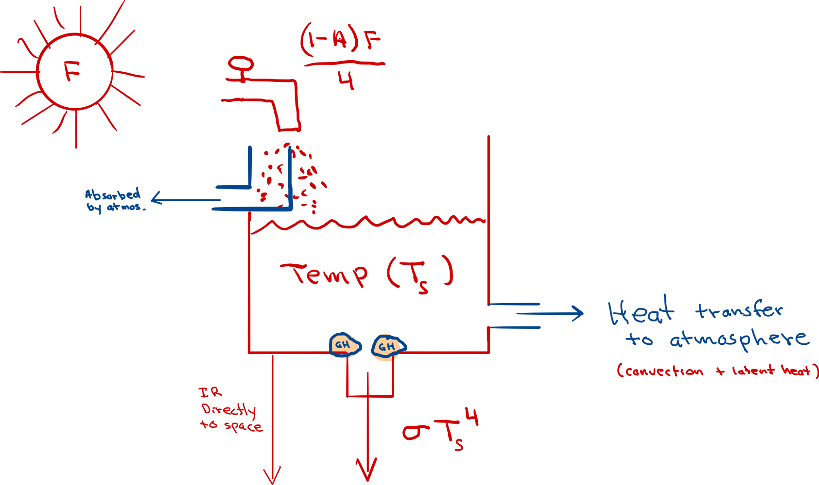
The layer model is too simple and needs to include other features that cool off surface temperatures.
These include:
Heat transport to atmosphere by convection (atmospheric circulation).
Latent heat transport to atmosphere by evaporated water.
IR emission from the surface that escapes directly to space.
Absorption of solar radiation by materials in the atmosphere.
When these features are included, our models predict
T_{s} = 288.4 K

Slide 17
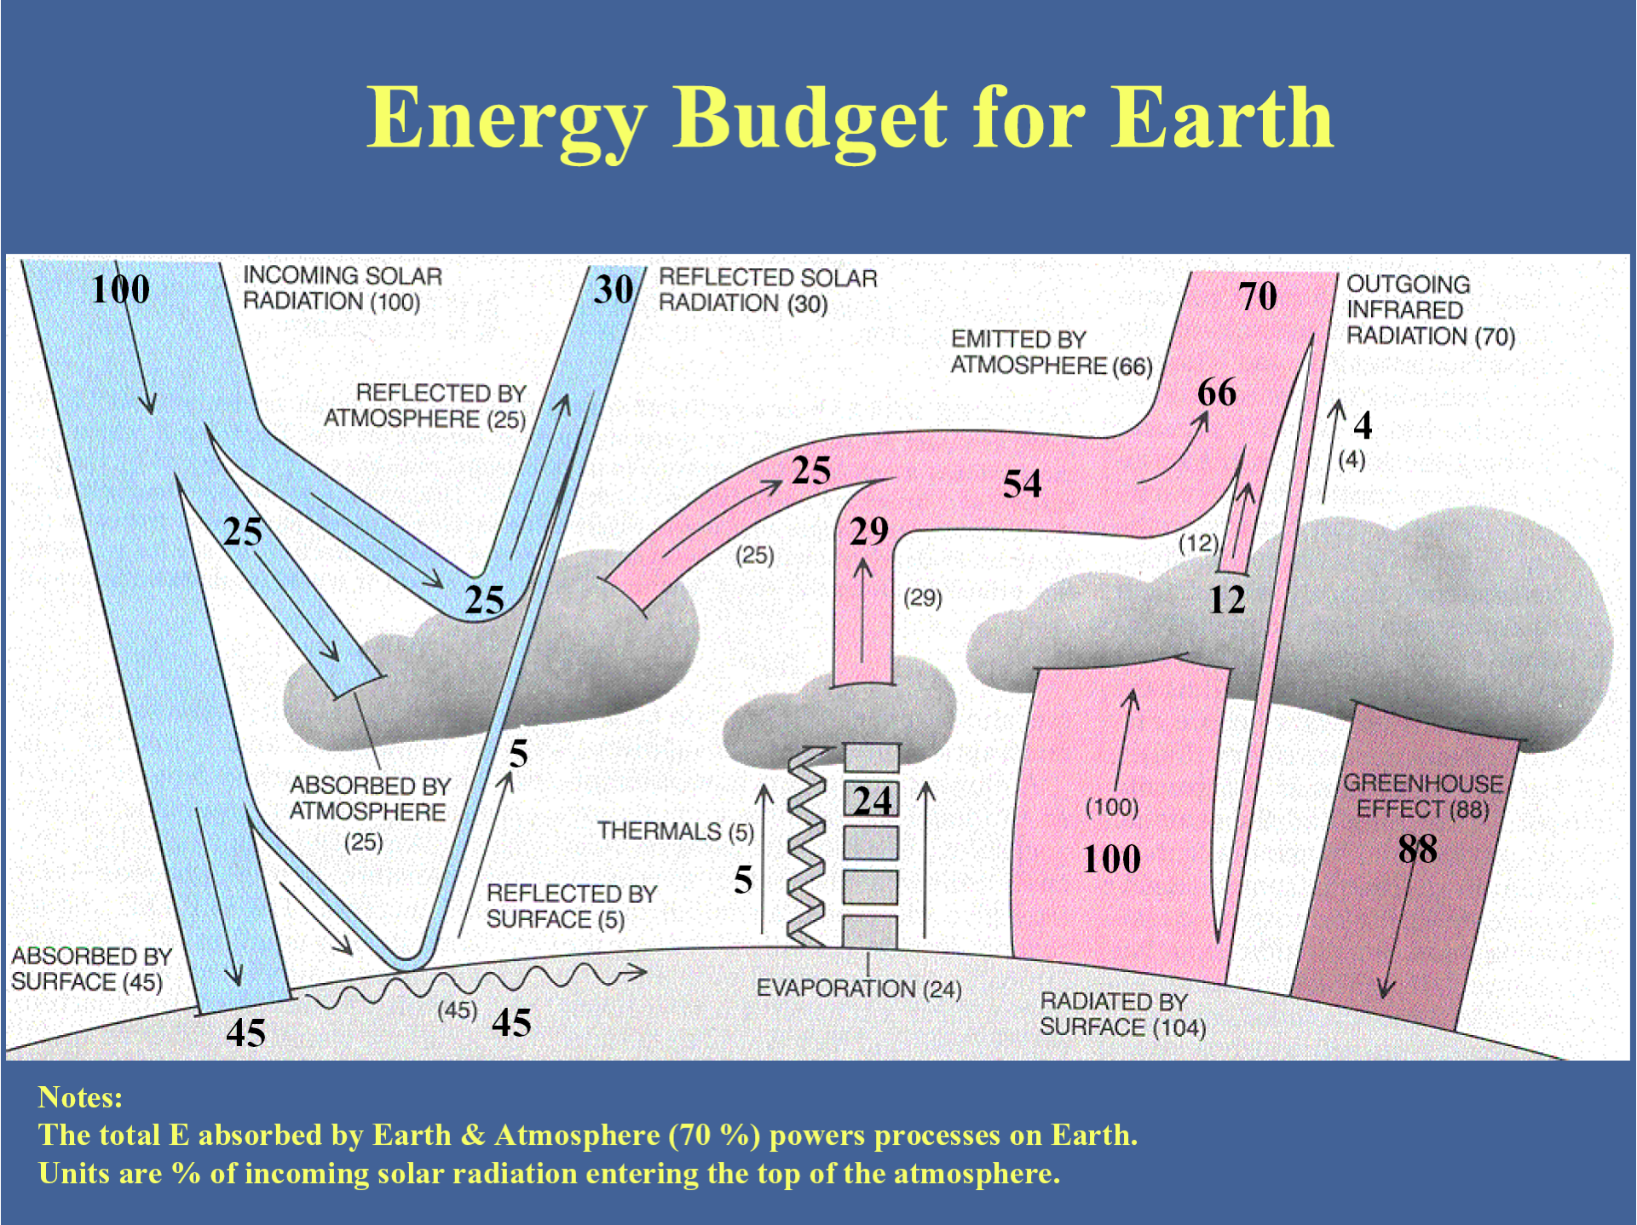
Solar radiation is not evenly distributed in space & the variations are important.

Slide 18
Lambert’s Cosine Law
Φ = Φ_{o} cos θ

Slide 19
Seasonal variation of solar flux on horizontal surface outside the atmosphere in the N. Hemisphere
Earth’s seasons caused by tilt, not distance.

Slide 20
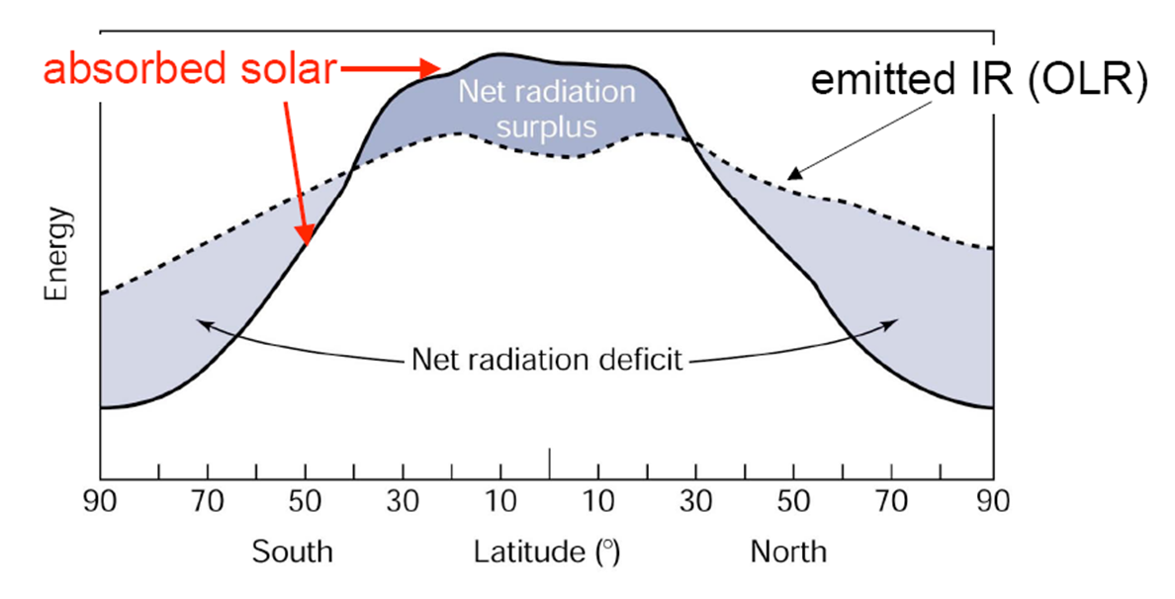
Spatial variations in radiation balance.

Slide 21
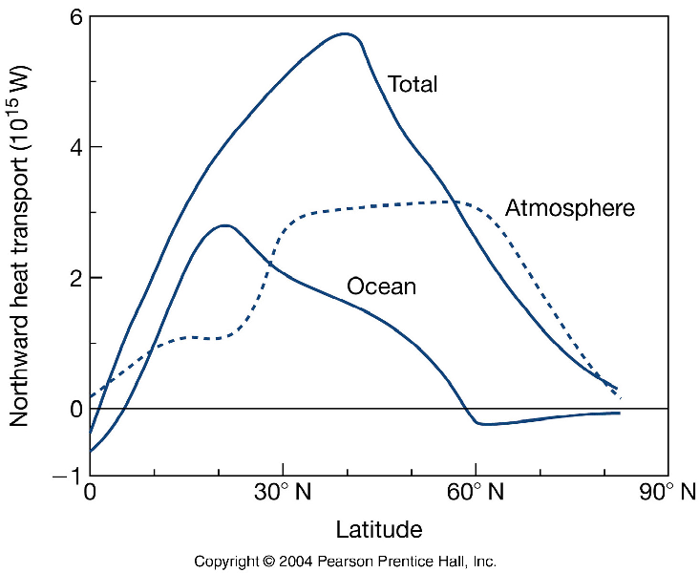
Kump et al. 2004
Rapid heat transport & anomalies quickly dissipate
Slow heat release & anomalies persist for long periods

Slide 22
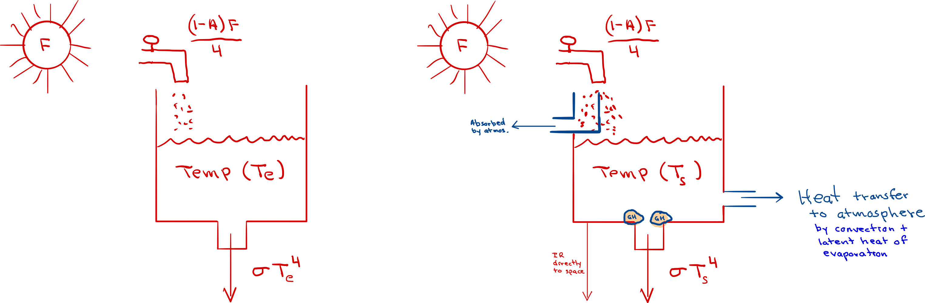
Climate Forcing
Change imposed on the planetary energy balance
that alters the global temperature of the Earth/atmosphere
system or the surface temperature.
Forcing Factors:
T_{e} altered only by solar constant & albedo
T_{s} also affected by GH effect; heat transfers;
& EMR absorbed by the atmosphere
There are both natural & anthropogenic forcings.

Slide 25
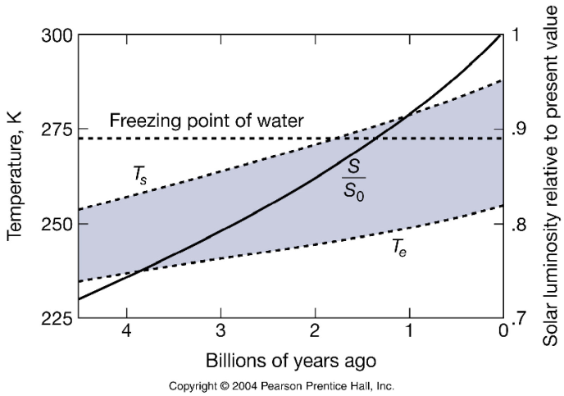
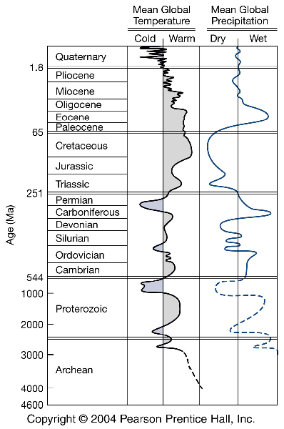
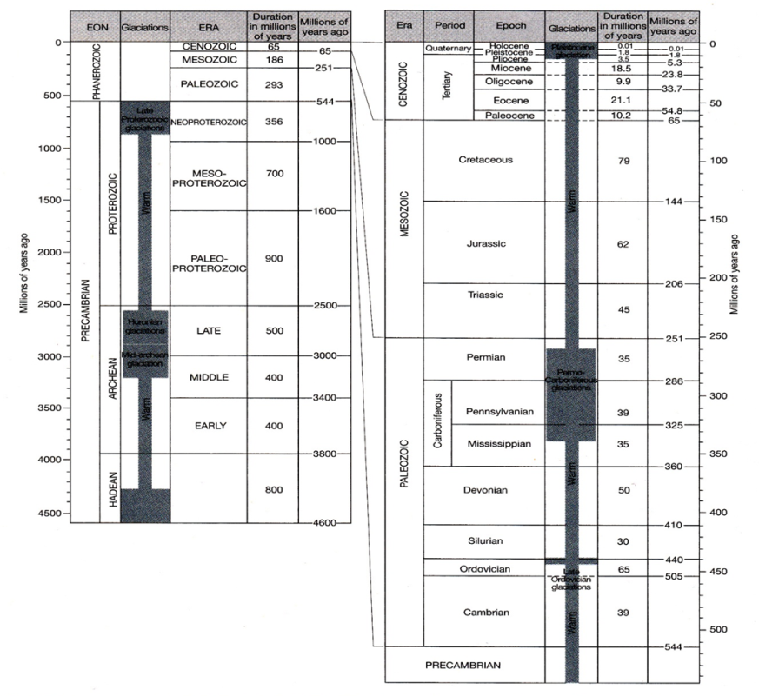
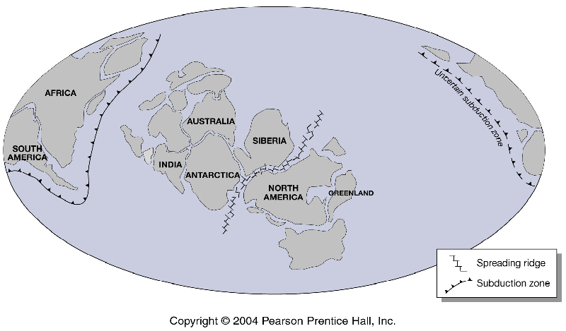
Faint Young Sun Paradox
Snowball Earth

Slide 26
?
Increasing solar luminosity; reduced GH effect
Sun 6% less luminous
Humans?

Slide 27
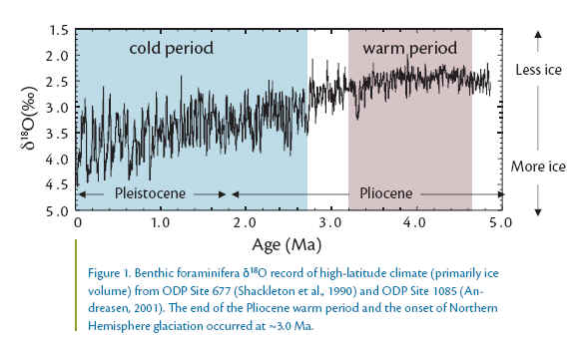
Notes:
http://climateaudit.org/2005/05/24/geological-perspective-2/
Hansen 2008 Target CO2 paper
We infer from Cenozoic data that CO2 was the dominant Cenozoic forcing, that CO2 was
~450 ± 100 ppm when Antarctica glaciate

Slide 28
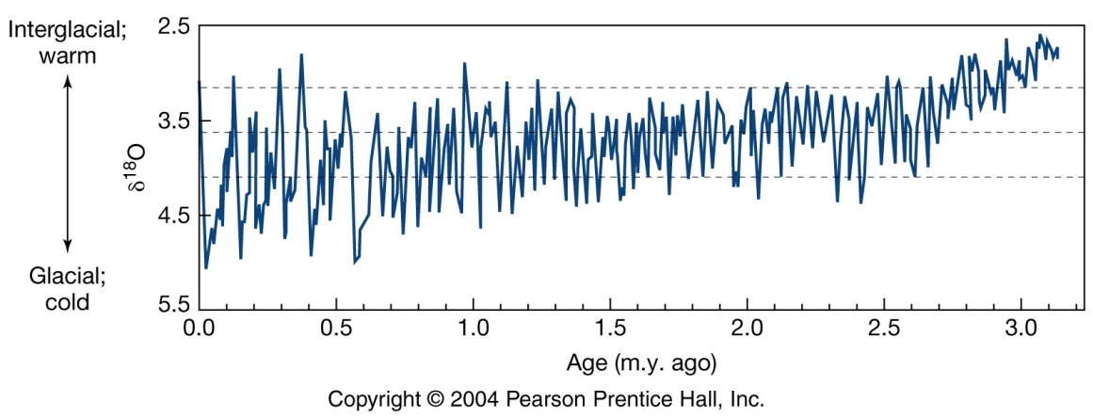
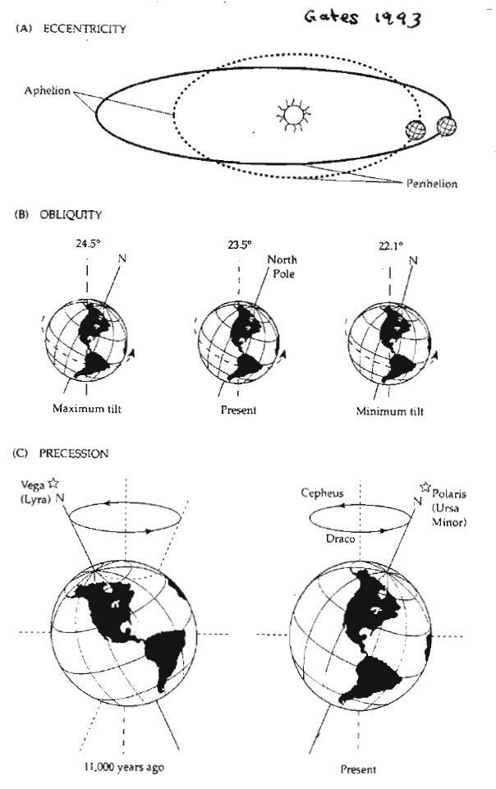
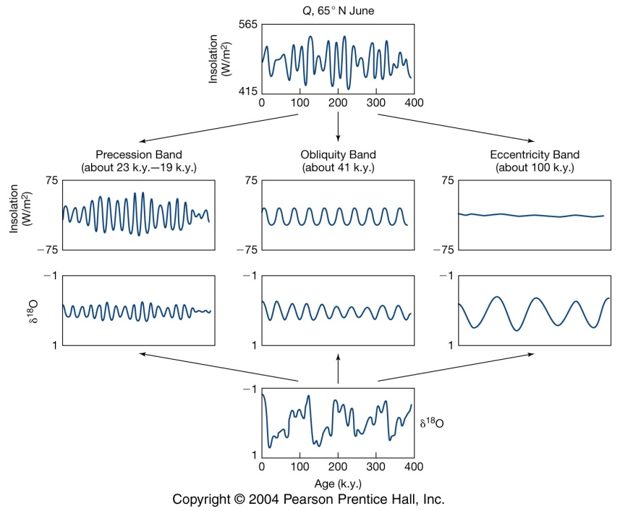
Deep-sea sediment core

Slide 29
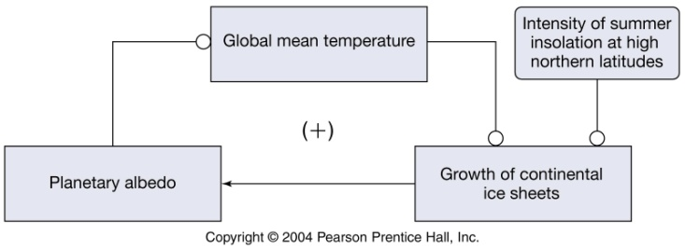
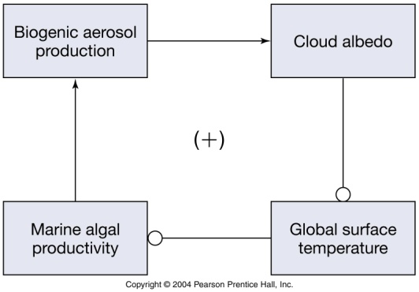
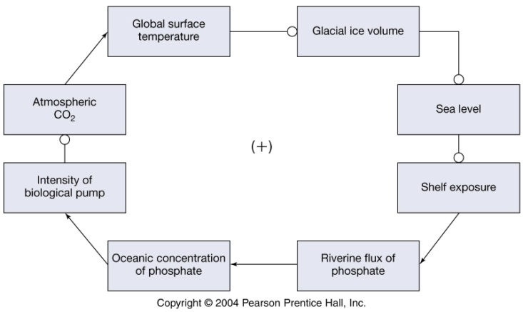
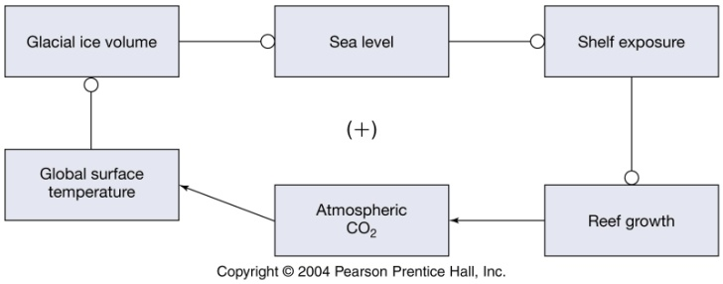
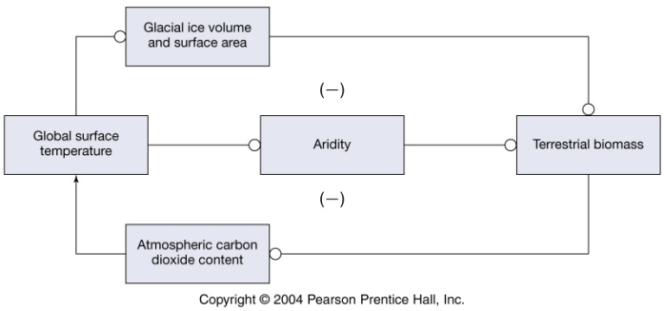
The 100,000 eccentricity signal
may have been amplified.
Ice-Albedo Feedback (+)
Cloud-Albedo Feedback (+)
Biological-Pump Feedback (+)
Coral Reef Feedback (+)
Ca₂⁺⁺ + 2HCO₃⁻ ➔ CaCO₃ + CO₂ + H₂O
Iron Fertilization Feedback (+)
Terrestrial Biomass Feedback (-)
CO₂
T _{surface}
Equator/Pole
_{Temp. Gradient}
Biological Pump in Ocean
Fe additions to ocean
E/W wind speed

Slide 30
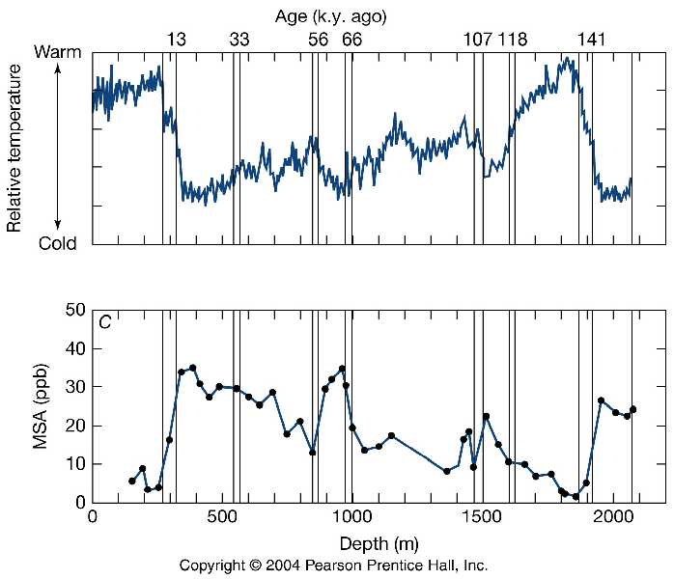

Slide 31
Schematic of paleotemperatures for the Phanerozoic. http://en.wikipedia.org/wiki/File: All palaeotemps.png, accessed Oct 20 2018. Compiled from multiple sources (information on website). As the methods used to determine temperature are not identical, the variations should be taken as relative and not absolute. However, the figure represents current thinking about relative temperature changes.
Teachable moments from the history of Earth’s climate
Climate optimum of the Pliocene (3.3 – 4.3 MYBP)
Mid-latitudes ~3-4º C warmer than pre-industrial
CO₂ < 450 ppm
Increased annual P
Eemian interglacial (125,000 – 130,000 YBP)
1-2º C warmer than pre-industrial
1-3º C greater warming > 50º N. Lat.
Increased regional P
[CO₂] ~ 300 ppm
Eccentricity driven
Holocene maximum (6,000-5,000 YBP; AKA Hypsithermal)
3-4º C warmer summers in high N. Lats.
1-2º C warmer summers in mid N. Lats.
Increased regional P & lake levels @ high Lats. & sub tropics
[CO₂] ~ 280 ppm
Orbital forcing
Younger Dryas (~12,000 YBP; lasted ~ 1,200 yrs)
6º C cooler in N. Atlantic (took ~100 years)
then warmed 7º C in ~1-3 year at the end
Changes in AMOC – example of climate tipping point
Little Ice Age (~1430 – 1850 AD)
~0.6º C cooler & highly variable climate
Increase in explosive volcanism
Decreased solar activity

Slide 32
The Real Inconvenient Truth Is That …
Global Change is More Than Global Warming
Changing atmospheric chemistry
Changes in global nutrient cycles
Changing atmospheric composition
Climate change
Stratospheric ozone depletion
Land-use change
Loss of biodiversity

